Slide 1
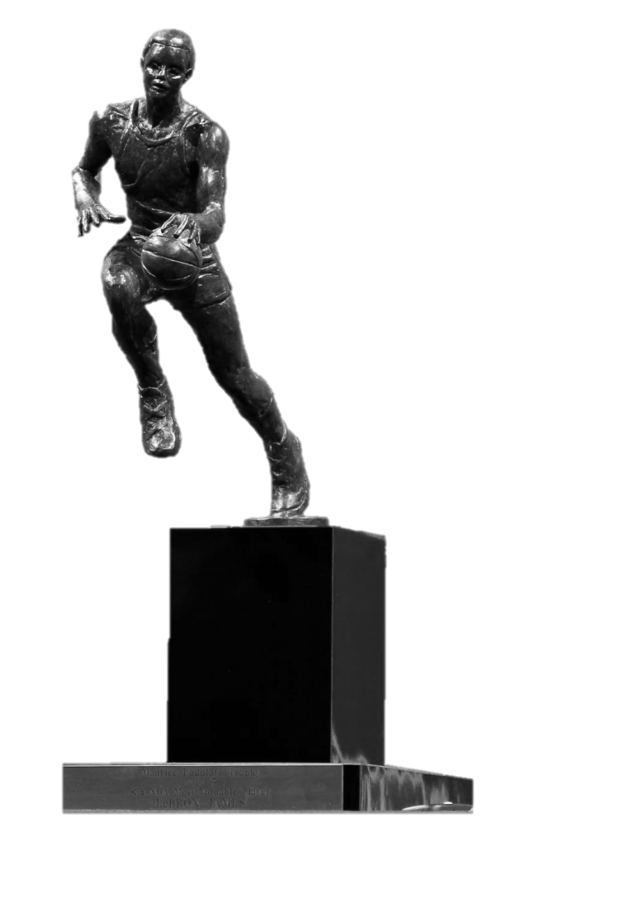
Predicting the NBA MVP using Data Science
Sebastian Peña: I wish I know who would win MVP in Advance, I would earn fortune by Gambling
Mayur Kumar: Well, Let’s build a model mate

Slide 2
Project Overview
Basketball has been one the sports most receptive and committed to the use of data to analyze all facets of the sport. Partnerships with Sportradar and Second Spectrum led to the installation of a multiple camera system for all arenas to capture moment and track statistics.
With this wave of data available, we asked ourselves: can we use data science to predict who will win the regular season MVP award before it is announced?
We used data from MVP voting dating back to the 1968-69 season. Additionally, we also used player stats for the 2018-19 season as our test data.
“I'll do whatever it takes to win games, whether it's sitting on a bench waving a towel, handing a cup of water to a teammate, or hitting the game-winning shot.”
- Kobe Bryant
Disclaimer: At time of writing, the NBA MVP for the 2018-19 season was already announced, but data, analysis, and model results are all previous to the announcement

Slide 3
MVPs in recent years have dominated the vote and have been clear winners
Season | Player | Votes | Maximum Votes | Award Share
2017-18 | James Harden | 965 | 1010 | 0.955
2016-17 | Russell Westbrook | 888 | 1010 | 0.879
2015-16 | Stephen Curry | 1310 | 1310 | 1
2014-15 | Stephen Curry | 1198 | 1300 | 0.922
2013-14 | Kevin Durant | 1232 | 1250 | 0.986
2012-13 | LeBron James | 1207 | 1210 | 0.998
2011-12 | LeBron James | 1074 | 1210 | 0.888
2010-11 | Derrick Rose | 1182 | 1210 | 0.977
2009-10 | LeBron James | 1205 | 1230 | 0.98
2008-09 | LeBron James | 1172 | 1210 | 0.969
Russel Westbook is the only player to win the MVP award with a team winning less than 51 games (<61% win pct)
The total votes cast has changed a lot recently. The current vote is comprised of 101 voters, each capable of giving up to 10 votes to a player
Regardless of the total votes cast, the threshold to win the MVP award remains extremely high

Slide 4
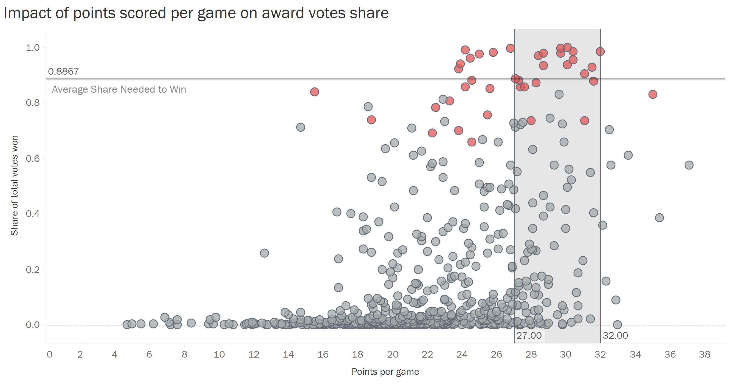
Scoring and winning are the primary drivers for the MVP award
Win percentage has the strongest trend of any "basic" metric. Intuitively, the most valuable player is highlighted because of the outstanding success of their team as a result of their performances.
Even with all the noise present in the graph, it is easy to see higher scoring generally translates to higher award share totals. In general, it seems a PPG value from 27 to 32 is the "sweet spot" for voters.
* Red circles are MVP award winners
“Good players want to be coached. Great players want to be told the truth.”
- Doc Rivers

Slide 5
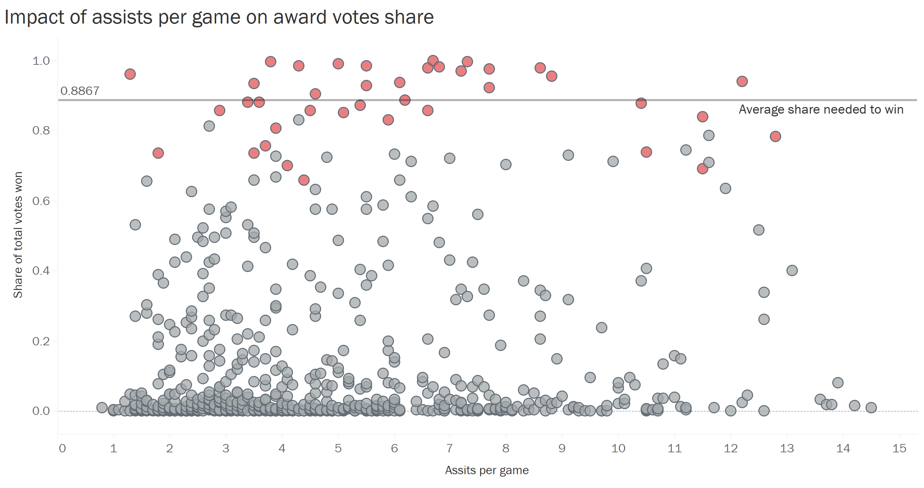
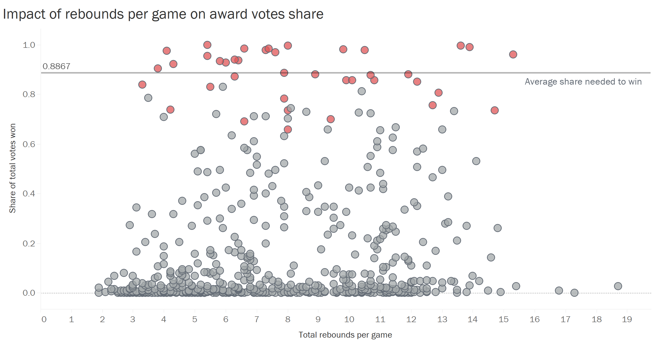
Team plays and defense is often under rewarded and does not look to change
Surprisingly, assists and rebounds per game do not seem to have any sort of overall trend in relation to MVP voting.
Defense doesn't seem to factor as much as it should, overshadowed by players who can score-at-will. That is not to say there are no players with high blocks per game who received the MVP award (i.e. Shaquille O' Neal).
* Red circles are MVP award winners
* Red circles are MVP award winners
However, all of them combined will serve to paint a much better picture, because just scoring is not enough to become the Most Valuable Player. It's necessary that a candidate be adequate in every basic statistic.

Slide 6
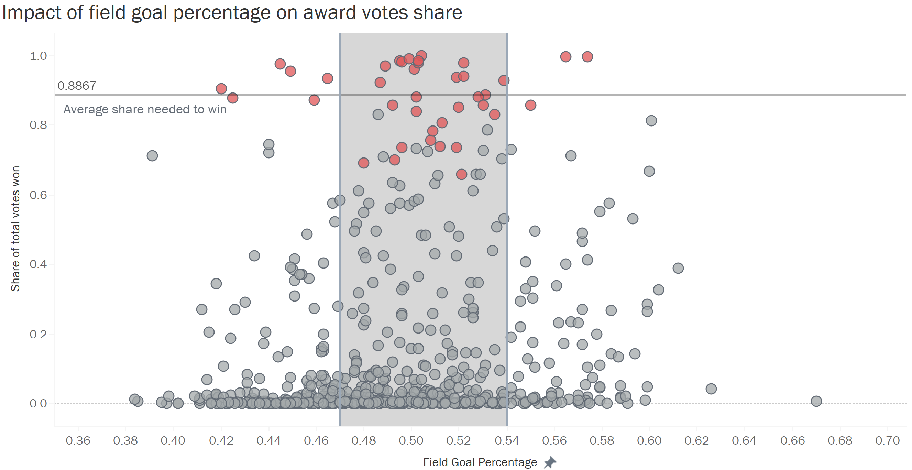
Shooting efficiency plays a role but exceptions to the rule do exist
Efficiency, however, does appear to be a significant cut-off factor for MVP winners. In the field goal percentage graph, most MVP winners have a shooting percentage between 0.47 and 0.54.
The 3-pointer does not see the same trend, mostly due to the 3-Point Revolution being very recent. The trend could change as more teams elect to shoot more 3-pointers as opposed to long 2-point shots.
Free throw percentage of at least 75% seems to be the minimum for those receiving the most points.
* Red circles are MVP award winners
“There is a lot of basketball beyond our control, but a player should never let anyone try harder than he does.”
- Dean Smith
Notes:
MVP winners below the threshold are known for taking many shots which impacts their percentage (i.e. Kobe Bryant, James Harden)
Those above the threshold focus more on close range shots and going to the basket (i.e. Lebron James, Shaquille O’Neal)

Slide 7
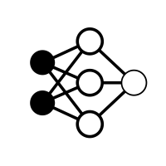
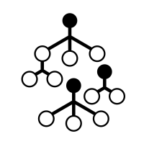
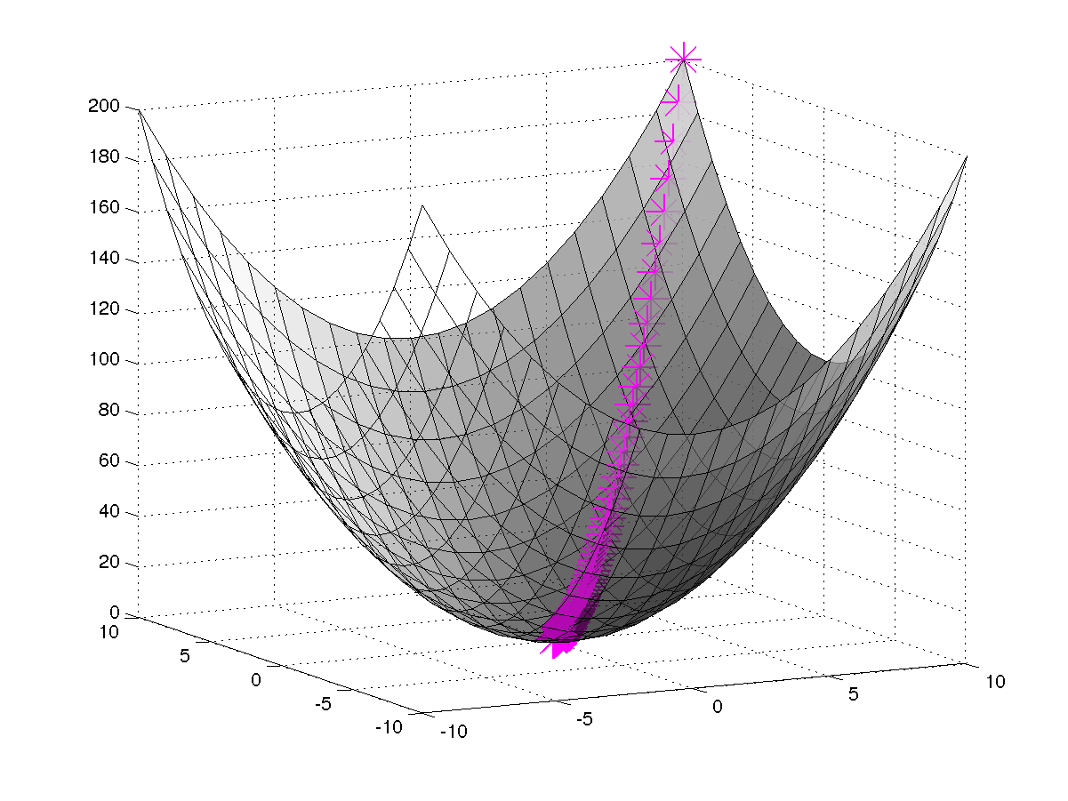
Multiple approaches to solve the same problem accurately and efficiently
Our objective being to predict which player will win the NBA MVP award, we had to develop a model that created a numeric prediction representing the number of votes each player would receive. We selected three modeling methods to try out:
Random Forest Regressor
Neural Network
Stochastic Gradient Descent Regressor
“Basketball is a lifelong game. You continue to learn from the game day in and day out, and all along the way, you get better.”
- Scottie Pippen

Slide 8

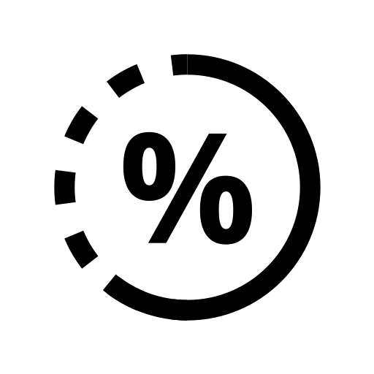
Modeling
We experimented with different variations for each algorithm to optimize the performance using MSE as our evaluative metric given the problem is a numeric prediction.
Additionally, we first set our target variable as the number of votes a player receives, but since the total number of votes cast has changed frequently throughout the years, we also looked at award share as our target variable.
“Once you are labeled the best you want to stay up there, and you can’t do it by loafing around. If I don’t keep changing, I’m history.”
- Larry Bird

Slide 9
Results for total vote count
We display the results yielded by the best model with each method, but we chose to use the predictions from the Random Forest Regressor Model because it had the smallest MSE.
The variation in total votes to cast throughout the years is clearly visible if we look at the neural network model output. While this model yields the same result as the random forest, the current voting structure has a maximum of 1,010 possible votes.
Rank | Player | Random Forest | Neural Net | SGD Regressor
1 | Giannis Antetokounmpo | 998 | 1322 | 754
2 | James Harden | 842 | 1298 | 795
3 | Damian Lillard | 654 | 766 | 485
4 | Kawhi Leonard | 633 | 471 | 289
5 | Nikola Jokic | 622 | 1210 | 559

Slide 10
Results for share of total votes
Similarly as before, we display all three model results, but chose to use the predictions from the Random Forest Regressor Model because it had the smallest MSE.
From the model we can see Giannis Antetokounmpo is predicted to win with 84.4% of the vote, slightly lower than the average share needed historically (88.7%). It is worth noting, the season has seen other players excel and produce incredible statistics such as James Harden’s 32 game 30-point streak.
Rank | Player | Random Forest | Neural Net | SGD Regressor
1 | Giannis Antetokounmpo | 0.844 | 1.456 | 0.733
2 | James Harden | 0.775 | 1.534 | 0.715
3 | Kawhi Leonard | 0.670 | 0.438 | 0.295
4 | Kevin Durant | 0.618 | 0.687 | 0.409
5 | Stephen Curry | 0.605 | 0.458 | 0.344

Slide 11
Summary
Professional basketball has seen an explosion in the use of data for player recruitment, development, and performance tracking. Teams have unprecedented access to player data
The NBA MVP award is one the greatest accomplishments in the sport and every year people and sports media alike spend hundreds of hours debating who will win it
Statistical analysis of MVP candidates shows scoring, scoring efficiency, and winning percentage as the key drivers for votes while defensive stats are often under rewarded
Through a variety of modeling approaches we generated a numeric prediction of the total number of votes won by a player as well as the share of all votes they incurred to predict the winner of the 2018-19 NBA MVP award
“There is no such thing as a perfect basketball player, and I don’t believe there is only one greatest player either.”
- Michael Jordan

Slide 12
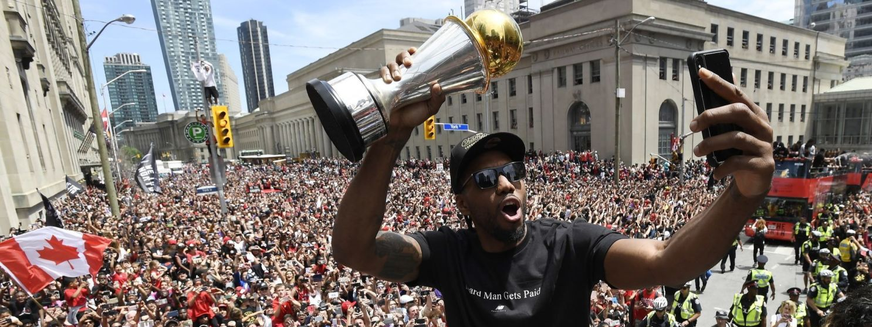
Thank You!
Questions?

